Slide 1
TEACHER’S PERSONAL INFORMATION
Name: Nguyen Thanh Loan
Facebook: Loan Nguyễn Thanh
Mobile number: 0942 255 937
Email: loannguyenthanh1978@gmail.com
Facebook lớp: …………….

Slide 2
ONLINE ASSIGNMENTS
https://www.helbling-ezone.com
Course: DH19QS-010112283701
Course ID: GDW5-2CT9

Slide 3
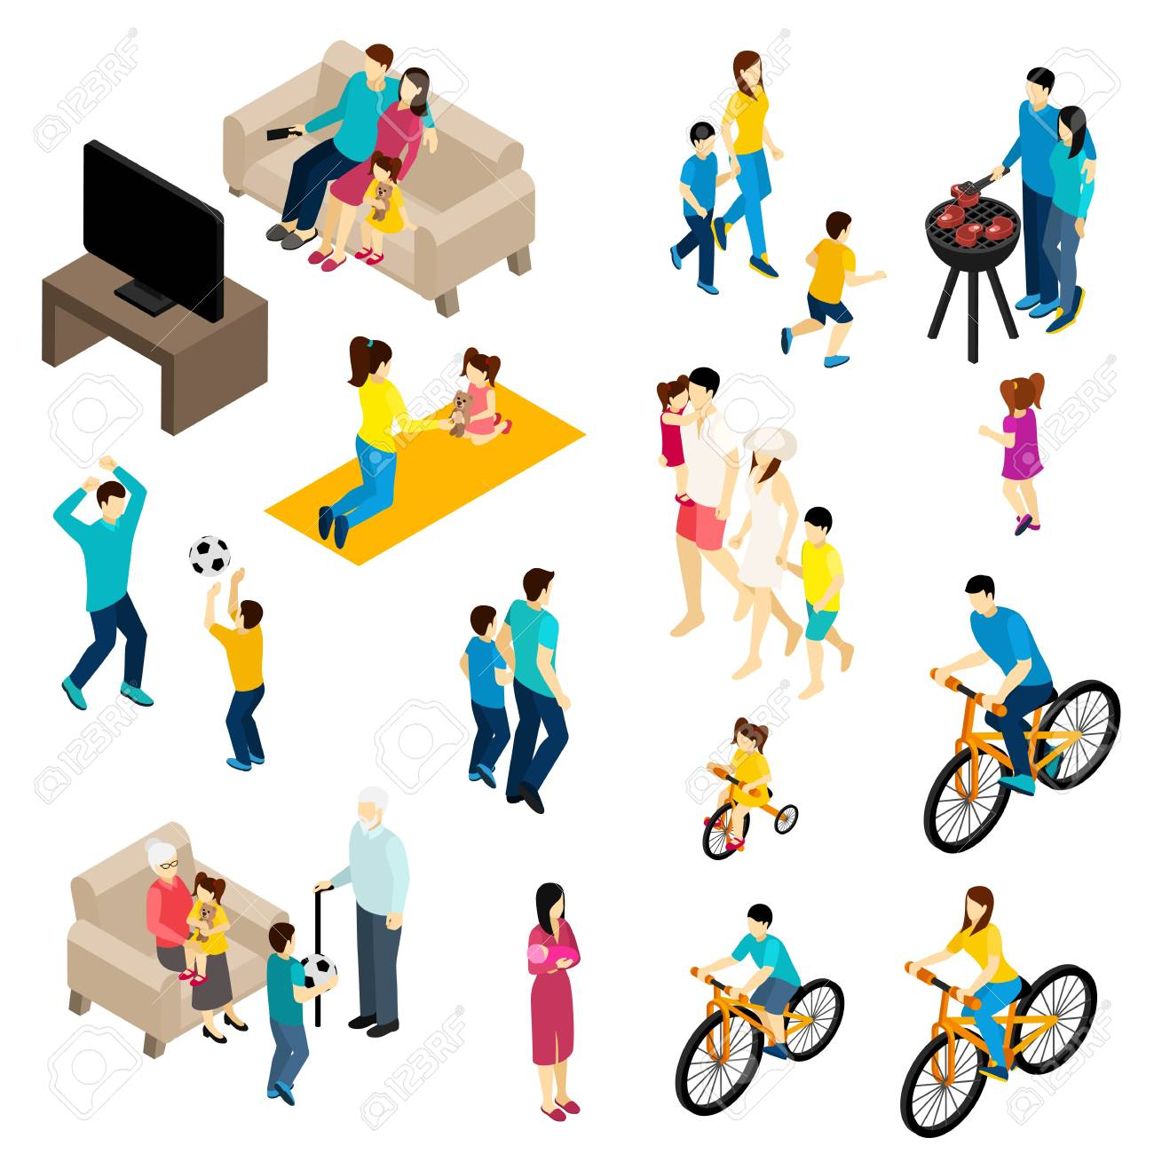
UNIT 3
FREE TIME

Slide 4
CONTENTS
Vocabulary: music, free time activities, days of the week.
Grammar: present simple, object pronouns, like/love/hate +V-ing form
Function: talking about likes and dislikes; making suggestions, agreeing and disagreeing.

Slide 5

VOCABULARY
Music
Listen to the types of music and guess the names of them
folk music 5. rock music
rap 6. jazz
classical music 7. pop music
country music 8. house music

Slide 6
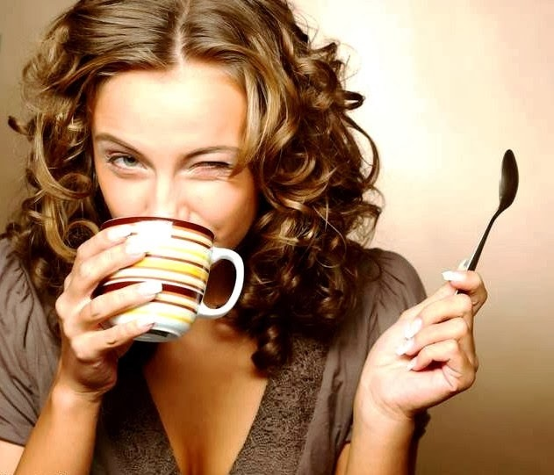
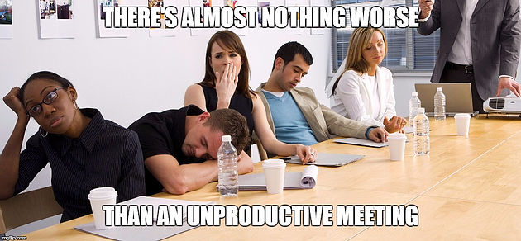
GRAMMAR
The present simple
Likes / dislikes
​Ex: I like drinking coffee.
​Ex: I don’t like meetings.
Grammar reference: p. 70

Slide 7
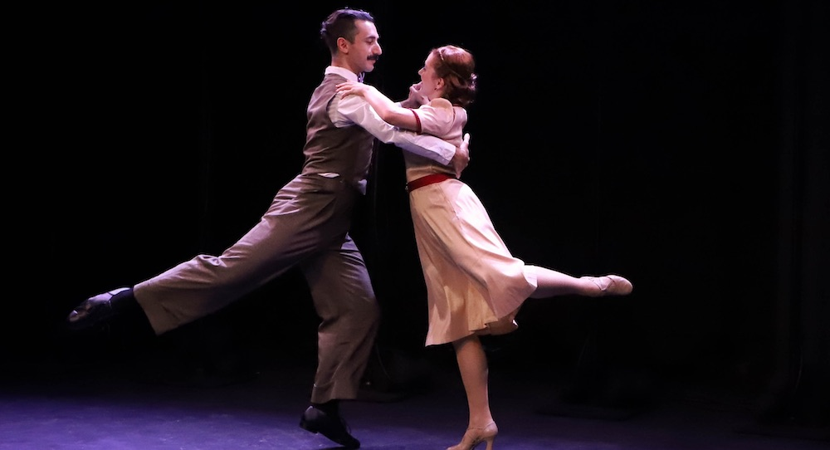
VOCABULARY
Free time activities
Dancing
/ˈdɑːnsɪŋ/
​moving your body to music
​Ex: I go to dancing classes three days a week.

Slide 8
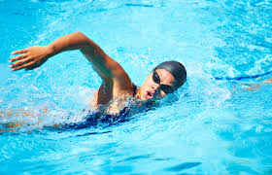
VOCABULARY
Free time activities
swiming
/ˈswɪmɪŋ/
​Ex: Swimming is a good form of exercise.

Slide 9
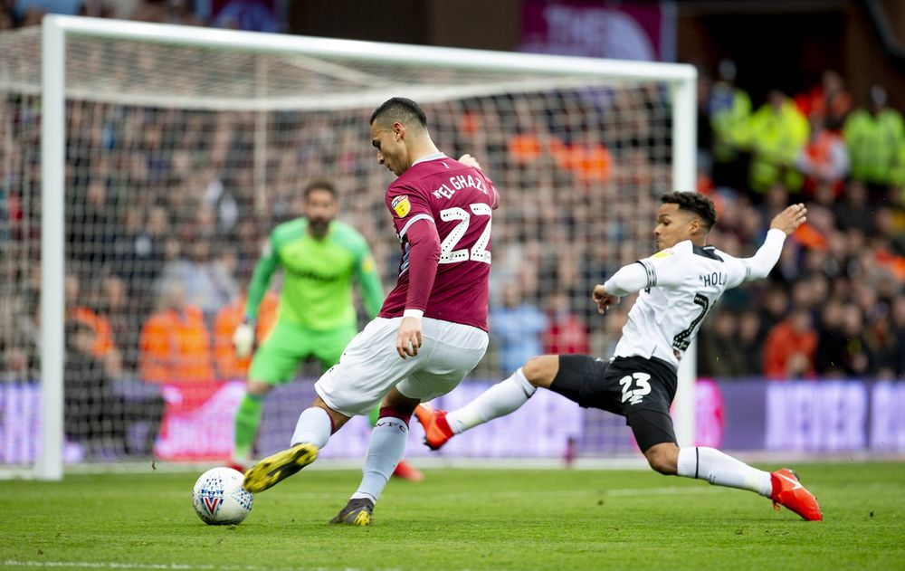
VOCABULARY
Free time activities
Playing soccer
/ˈsɒkə(r)/
​a game played by two teams of 11 players, using a round ball which players kick up and down the playing field. Teams try to kick the ball into the other team’s goal.
​Ex: I played soccer when I was younger.

Slide 10
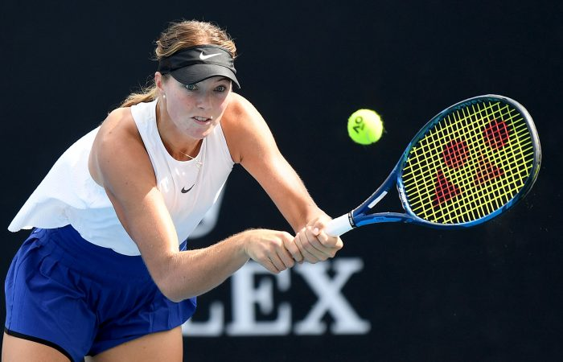
VOCABULARY
Free time activities
Playing tennis
/ˈtenɪs/
​a game in which two or four players use rackets to hit a ball backwards and forwards across a net on a specially marked court to play tennis
​Ex: I met a friend for a quick game of tennis after work.

Slide 11
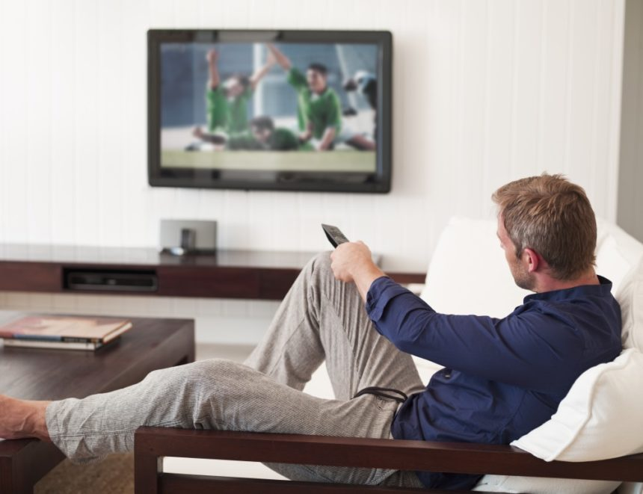
VOCABULARY
Free activities
Watching TV/movies
/wɒtʃ/
​Ex: Most people like watching TV.

Slide 12
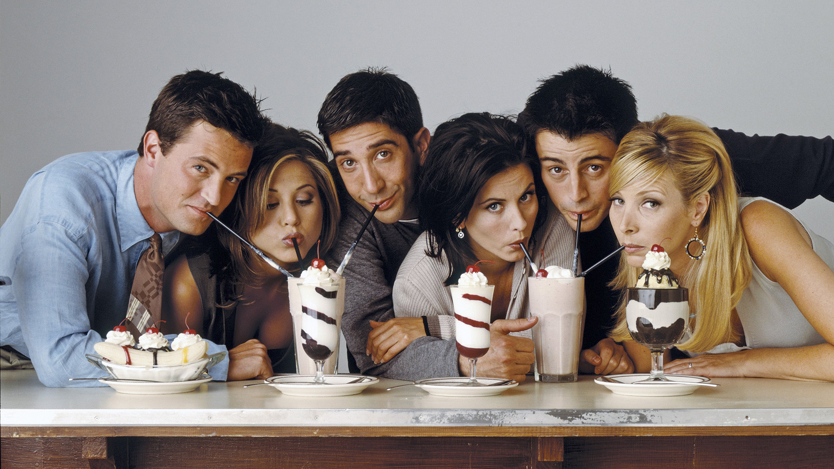
VOCABULARY
Free time activities
Spending time with friends
/spend/
​Ex: At the weekend I spend time with my friends to relax.

Slide 13
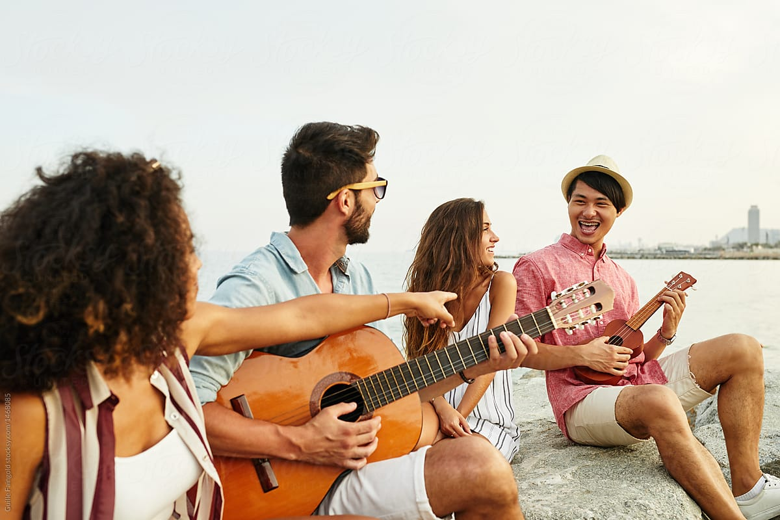
VOCABULARY
Free time activities
Playing music
//ˈpleɪɪŋ ˈmjuːzɪk/
​Ex: They like playing music together.

Slide 14
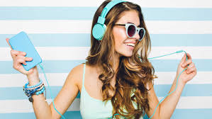

VOCABULARY
Free time activities
Listening to music
​Ex: Boys and girls like listening to music.

Slide 15
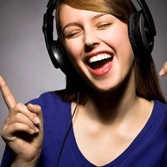

GRAMMAR
Like/love/hate
I like/love music
I like/love listening to music
I hate soccer.
I hate playing soccer.
Like/love/hate + noun/
Like/love/hate + V-ing

Slide 16
SPEAKING
Make sentences with like/love/hate and these types of music.
folk music 5. rock music
rap 6. jazz
classical music 7. pop music
country music 8. house music

Slide 17


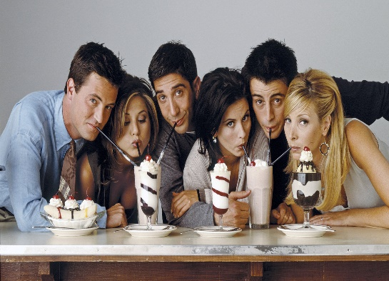
Make sentences with like/love/hate and these activities.

Slide 18
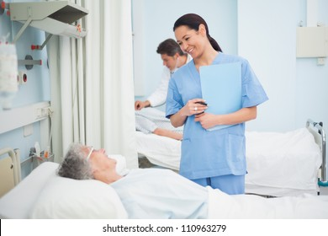

GRAMMAR
The present simple
Things that are true in general
​Ex: Nurses look after patients in hospital.
​Ex: I meet a lot of students at work.
Grammar reference: p. 70

Slide 19
GRAMMAR
The present simple
Forms
​(+) I/You/We/They + Verb
​Ex: The children like going out with their friends.
​(-) I/You/We/They + do not (don’t) + Verb
​Ex: I don’t usually get up early in the morning.
​(?) Do I/You/We/They + Verb?
​Ex: Do you go to evening classes?
Yes, I do / No, I don’t.
Grammar reference: p. 70

Slide 20
GRAMMAR
The present simple
Questions with question words
​(?) Question word + Do I/You/We/They + Verb?
​Ex: What do you like?
I like coffee.
​Ex: Why do you drink coffee?
Because it helps me to concentrate on my work.
​Ex: When do you have English classes?
I have English classes on Monday, Wednesday, and Friday.
Grammar reference: p. 70

Slide 22

VOCABULARY
parties
/ˈpɑːti/
​a social occasion, often in a person’s home, at which people eat, drink, talk, dance and enjoy themselves
​Ex: I was at a birthday party for my friend's five-year-old daughter.

Slide 23
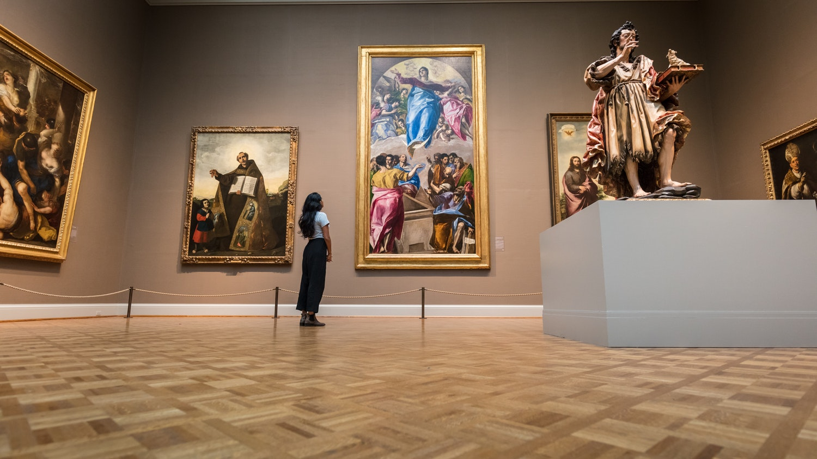
VOCABULARY
museum
/mjuˈziːəm/
​a building in which objects of artistic, cultural, historical or scientific interest are kept and shown to the public
​Ex: They visited museums and galleries throughout the city.

Slide 24
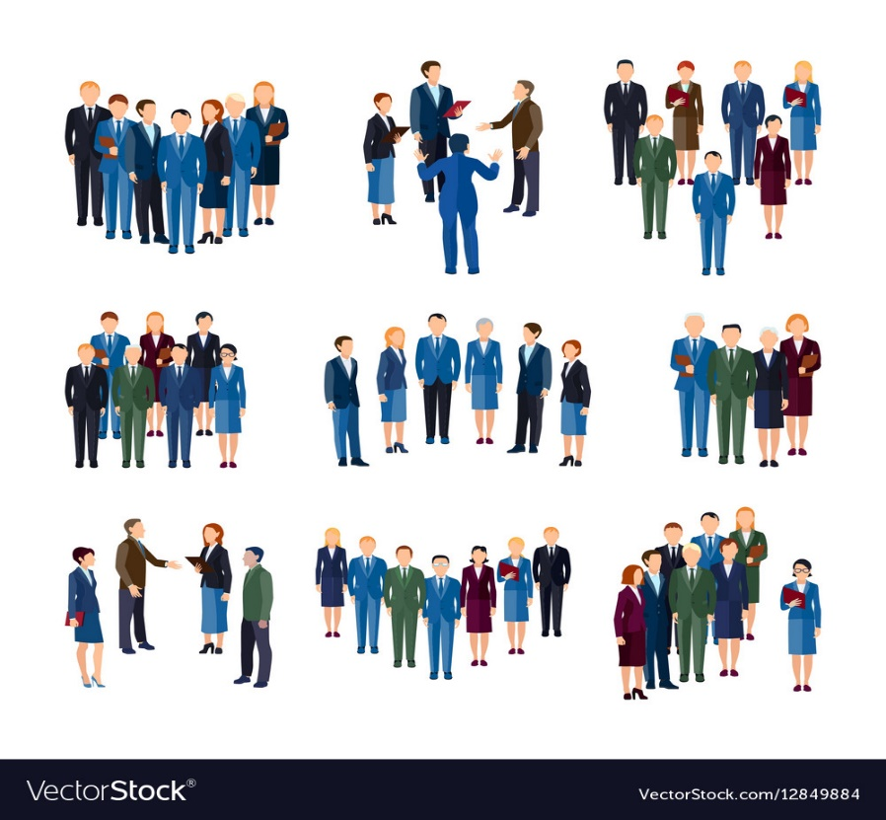
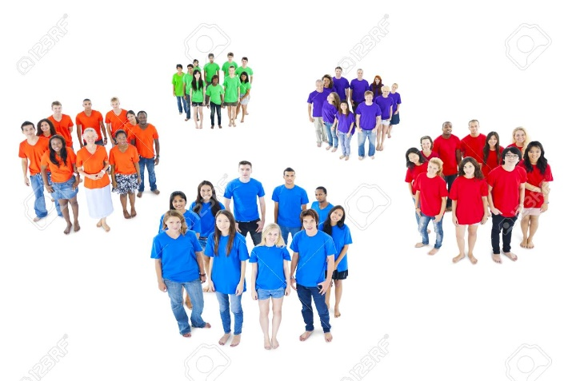
VOCABULARY
Groups of people
/ɡruːp/
​a number of people or things that are together in the same place or that are connected in some way
​Ex: A group of us are going to the theatre this evening.

Slide 25
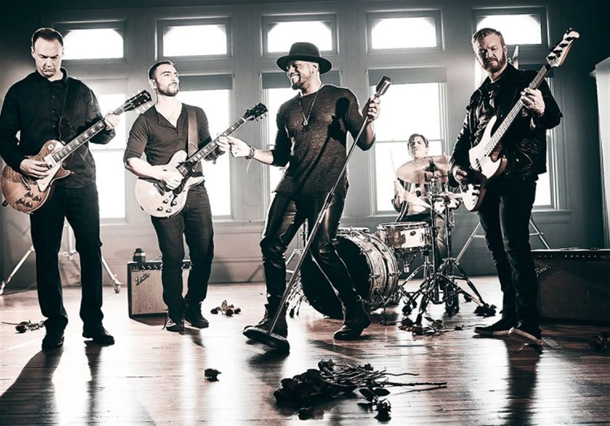
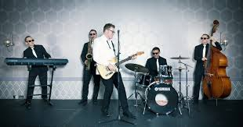
VOCABULARY
band
/bænd/
​a small group of musicians who play popular music together, often with a singer or singers
​Ex: He plays drums in a band that he formed with some friends.

Slide 26


VOCABULARY
favorite
/ˈfeɪvərɪt/
​Ex: My favorite type of film is action film.

Slide 27
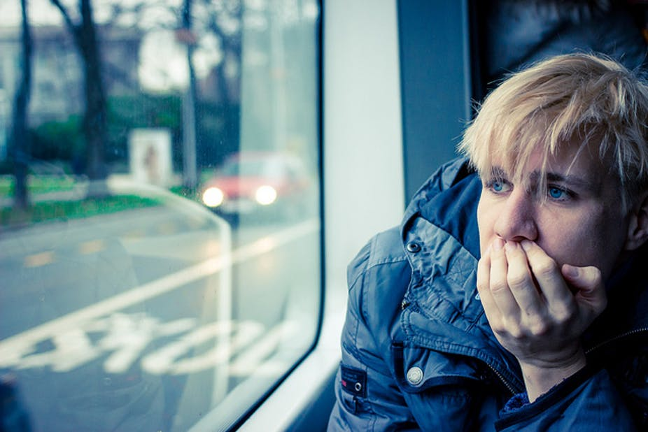
VOCABULARY
introvert
/ˈɪntrəvɜːt/
​a quiet person who is more interested in their own thoughts and feelings than in spending time with other people
​Ex: He was described as an introvert, a reserved man who spoke little.

Slide 28

VOCABULARY
talk
/tɔːk/
​ to say things; to speak in order to give information or to express feelings, ideas, etc.
​Ex: We talked on the phone for over an hour.

Slide 29

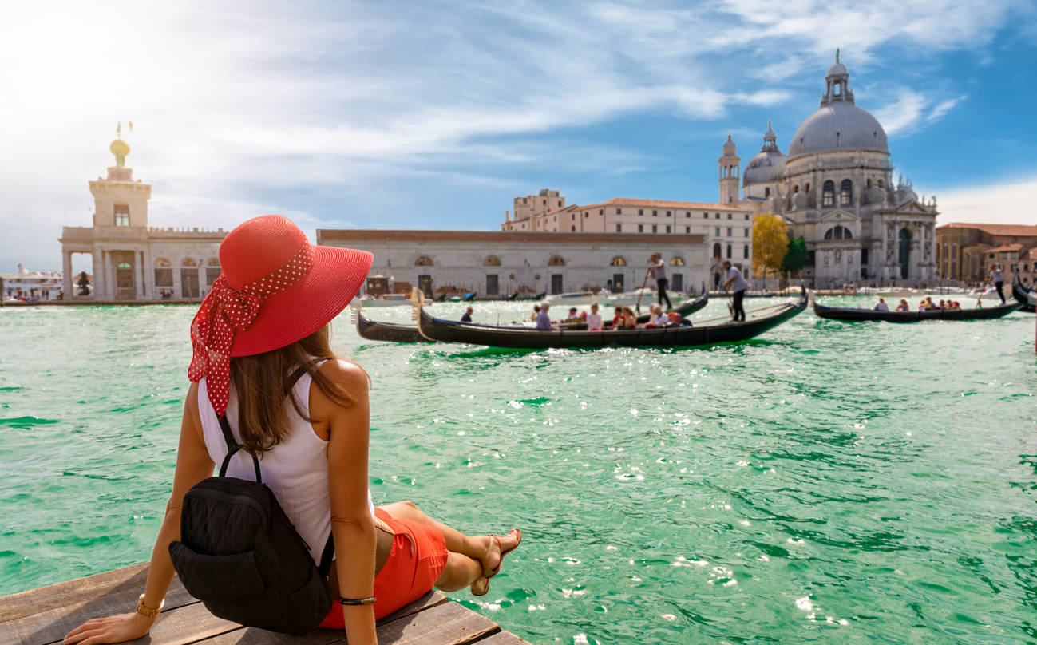
VOCABULARY
travel
/ˈtrævl/
​to go from one place to another, especially over a long distance
​Ex: We always travel first class.

Slide 30
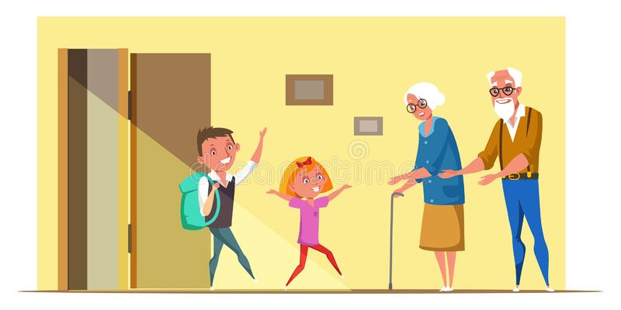
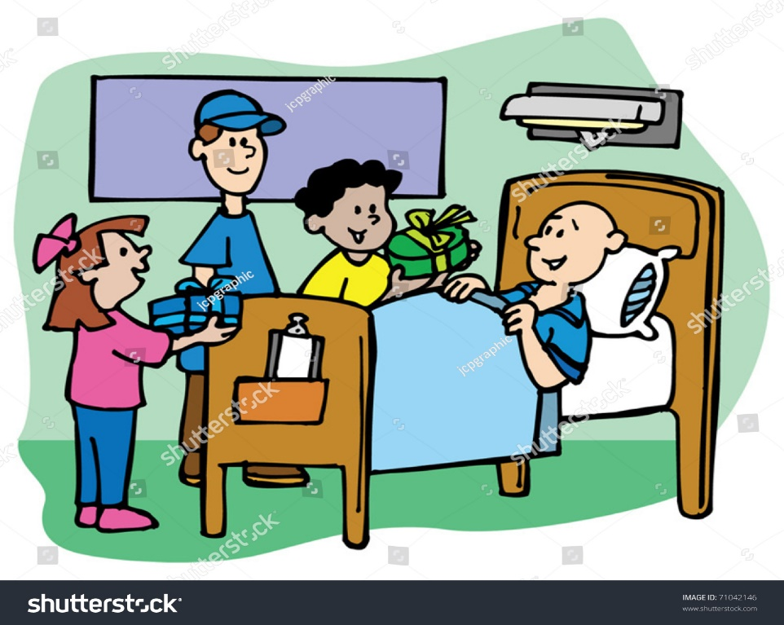
VOCABULARY
visit
/ˈvɪzɪt/
​to go to see a person or a place for a period of time
​Ex: My parents are coming to visit me next week.

Slide 31


VOCABULARY
work
/wɜːk/
​to do something that involves physical or mental effort, especially as part of a job
​Ex: The whole team is currently working on the project.

Slide 32

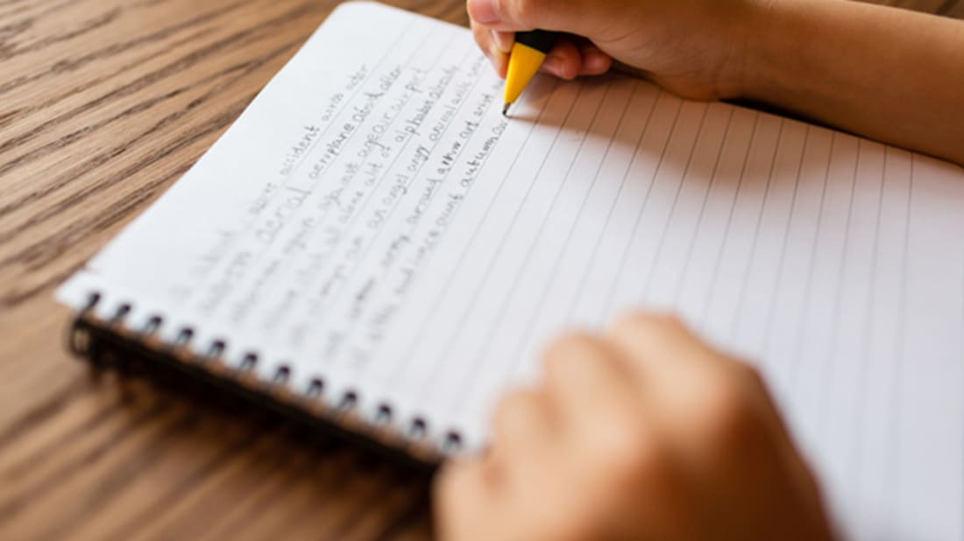
VOCABULARY
write
/raɪt/
​to make letters or numbers on a surface, especially using a pen or a pencil
​Ex: In some countries children don't start learning to read and write until they are six.

Slide 33
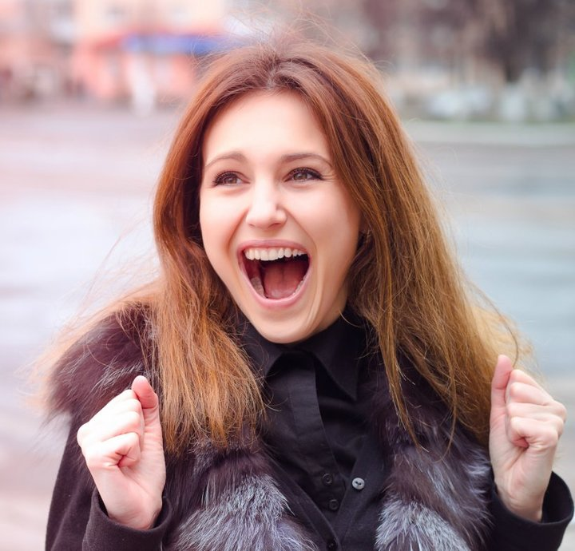
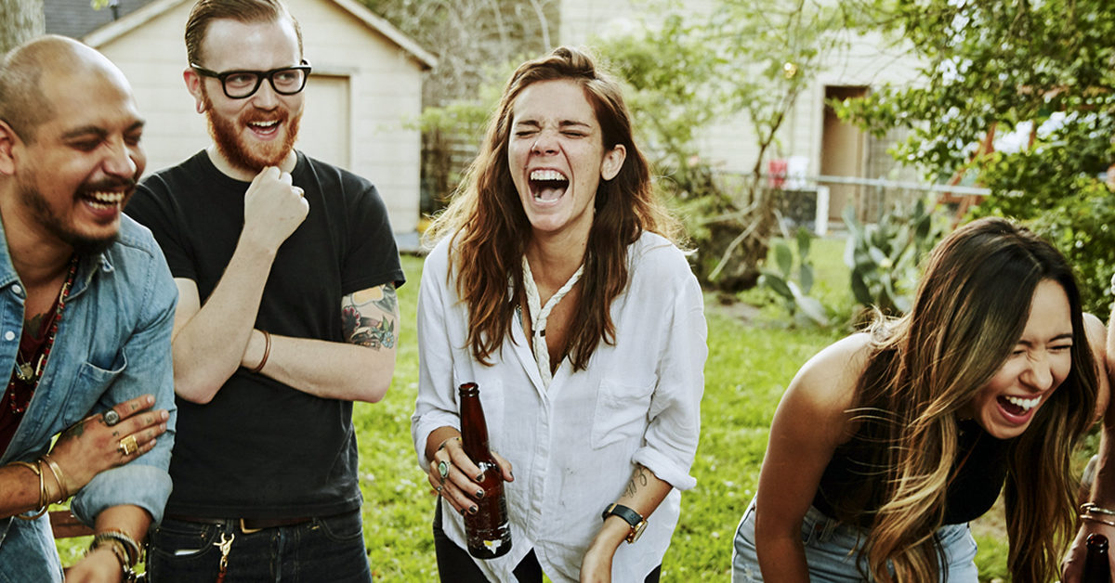
VOCABULARY
extrovert
/ˈekstrəvɜːt/
​a lively and confident person who enjoys being with other people
​Ex: She's a real extrovert and loves to socialize and meet new people.

Slide 34
EXERCISES
Do exercises 1, 3, 4 on page 24.
Listening: Do exercises 7, 8 on page 25.

Slide 35
GRAMMAR
Read the text below.
I have a son and a daughter. The son is 6 years old. The son likes playing soccer. I usually take the son to the stadium 3 days a week. The daughter is 9 years old. The daughter likes playing the piano. The daughter goes to the piano classes 2 days a week in the afternoon and my husband takes my daughter to her class. My husband and I talk to my son and daughter a lot so that we can understand my son and daughter more.

Slide 36
GRAMMAR
Read the text below.
I have a son and a daughter. The son is 6 years old. The son likes playing soccer. I usually take the son to the stadium 3 days a week. The daughter is 9 years old. The daughter likes playing the piano. The daughter goes to the piano classes 2 days a week in the afternoon and my husband takes my daughter to her class. My husband and I talk to my son and daughter a lot so that we can understand my son and daughter more.

Slide 37
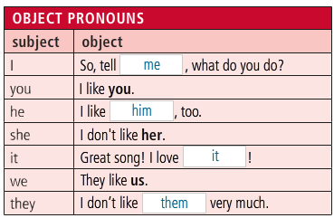
GRAMMAR
Đại từ tân ngữ đứng ở vị trí tân ngữ (đằng sau động từ hoặc giới từ, thay thế cho danh từ). Bạn cần phân biệt rõ đại từ tân ngữ với đại từ chủ ngữ. Chủ ngữ là chủ thể của hành động (gây ra hành động), còn tân ngữ là đối tượng nhận sự tác động của hành động.

Slide 38
Subject pronouns | Object pronouns | Example
I | me | I have a best friend. She helps me a lot in studies.
You | you | You are my little child. I love you so much.
We | us | We live in the country. My friends visit us every summer.
They | them | Huong and Mai are my old friends at university. I often write to them.
She | her | My cousin Ly is kind. Every one loves her.
He | him | Where is your son? I can’t see him.
It | it | The house is very nice. I really like it

Slide 39
EXERCISES
Do exercise 3 on page 15 (workbook).

Slide 40
EXERCISES
Choose the correct object pronouns
1. I really like Katie, but she never notices _______
2. My brother lives in Mexico. I don’t see _______very often.
3. This worksheet is hard. I’m not sure I can do _______.
4. How are your parents? I haven’t seen _______for ages.
5. Lisa really likes David, but he doesn’t like_______.

Slide 41
EXERCISES
Choose the correct object pronouns
6. This dress looks a bit small. Do you think it will fit _______?
7. Star Wars is a fantastic film. I love watching _______.
8. Your boss called. He wants to speak to_______.
9. Where is my text book? I can’t find _______.
10. Jessica is really nice. I like _______ a lot.
11. I see my friends everyday. I always have lunch with_______ .

Slide 42
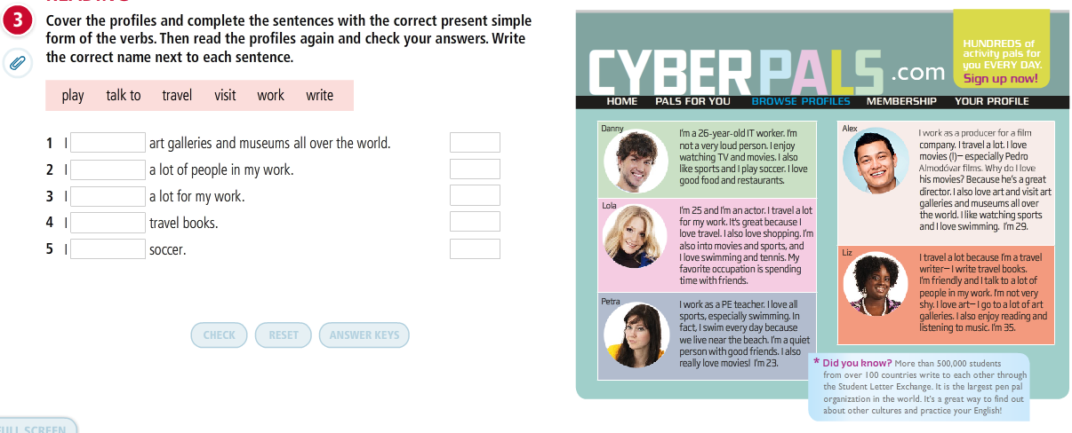
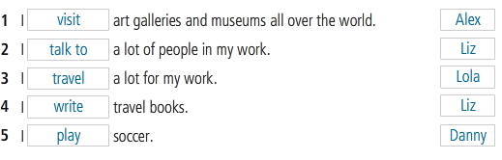
READING

Slide 43
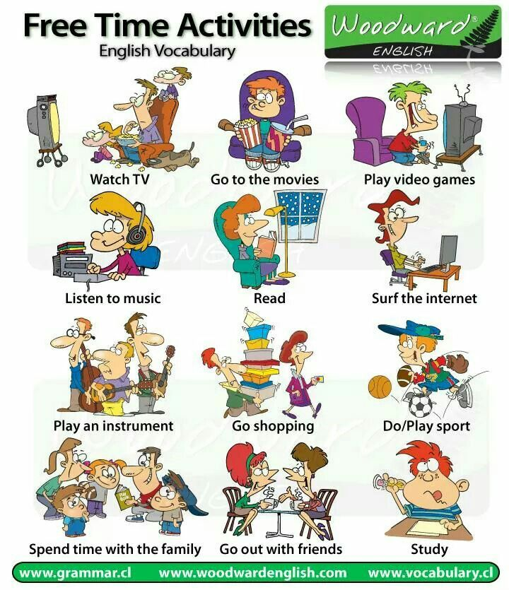

Slide 44
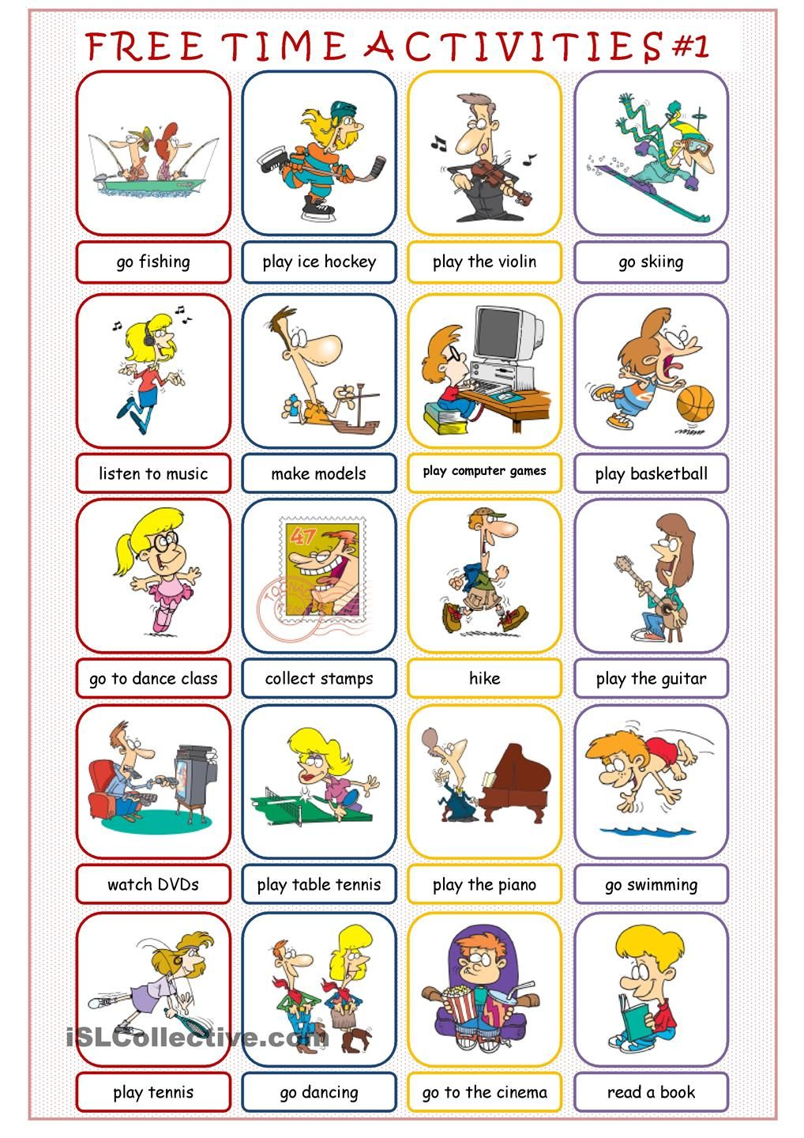

Slide 45
WRITING
Write a profile about yourself for the site above. Include true and false information.
Exchange your profile with a partner. Find out if you are a good match.

Slide 46
The end!

